Slide 1
Banking Buisness case(data analysis assessment)
Madan K

Slide 2
Problem Statement: A major bank in Middle East came to NeoStats with help in analysing its current customer base and its marketing campaigns. It wants to understand which customers are most likely to take a term deposit (fixed deposit), and then send this list to their call centre. Goal of Project: we have to create classification model for bank so that it makes more easier to them identify the customers who likely to subscribe the Term Deposit(Fixed Deposit)
Flow for analysis and model building:
Data Preprocessing
EDA
Visualizations and Reporting
Correlation and Clustering analysis
Feature engineering
Model Building and Evaluation
Conclusion and Insights:

Slide 3
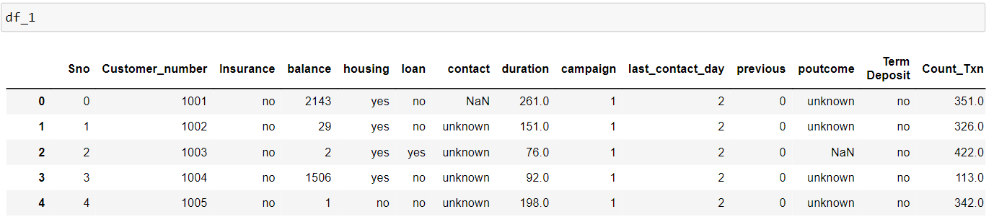
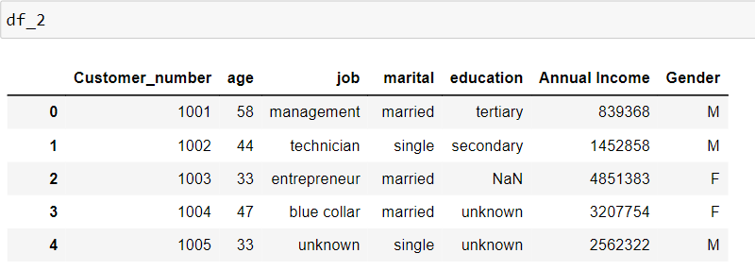
Dataset:
It contains two dataset where one dataset(45211 rows × 14 columns) consist of customers transaction details and other dataset(45211 rows × 7 columns) details of customer demographic information.

Slide 4
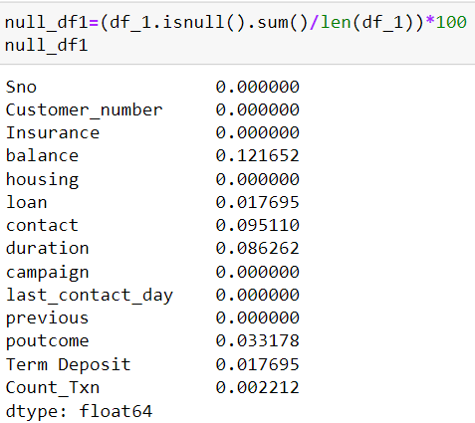
Preprocessing Transaction Details Data (df_1):
As we can see very small percentage of null values in features balance,loan,contact,duration,poutcome,Term Deposit,Count_Txn
Check For Duplicates:
There are no duplicate rows in df_1 dataset
will carry out the null value imputation based on their distribution for numerical features and replace with mode in categorical feature

Slide 5
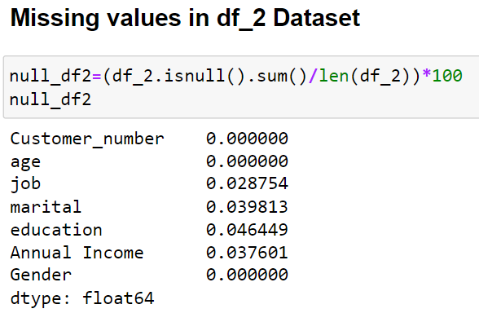
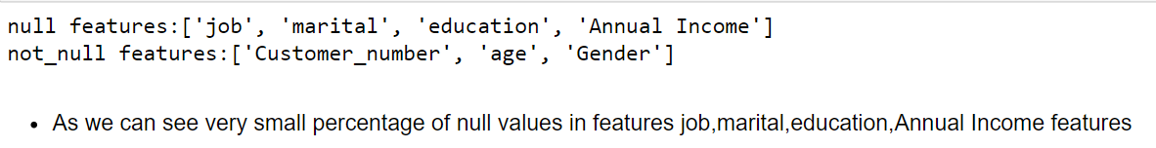
Preprocessing Transaction Details Data (df_2):
Check For Duplicates:
There are no duplicate rows in df_2 dataset
will carry out the null value imputation based on their distribution for numerical features and replace with mode in categorical feature

Slide 6
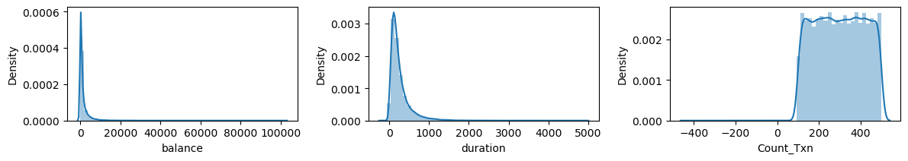
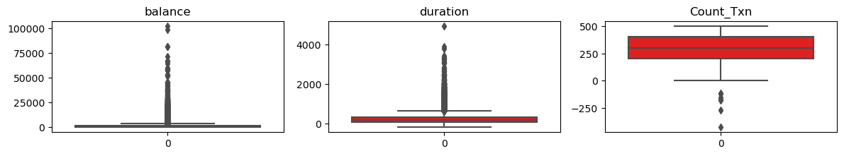
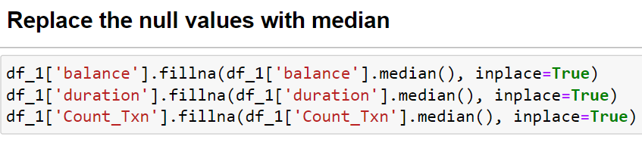
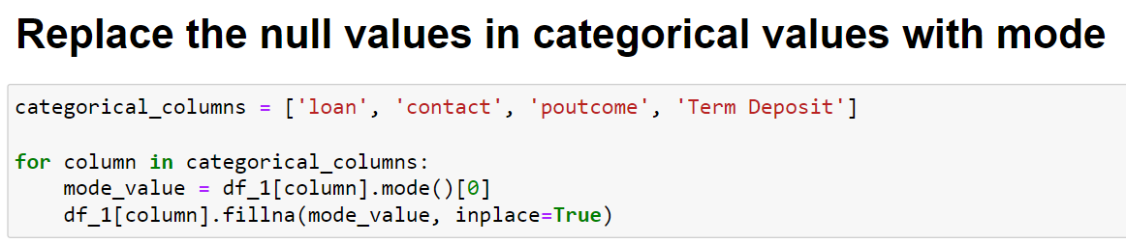
Null imputation based on distribution of Numerical Features(dataset 1):
Features such as balance,duration are rightly skwed and Count_Txn are negatively skewed so its better replace the null values by median
Skewed features such as 'balance', 'duration', and 'Count_Txn' are better to be imputed with the median rather than the mean. The median is less sensitive to outliers and provides a better representation of the central tendency in skewed distributions.

Slide 7
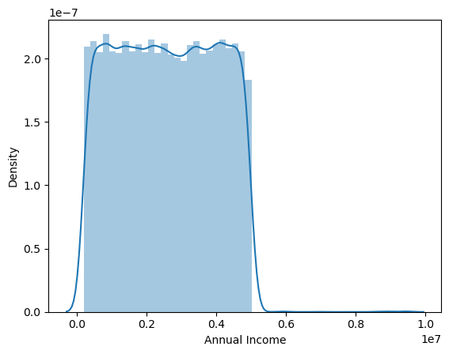
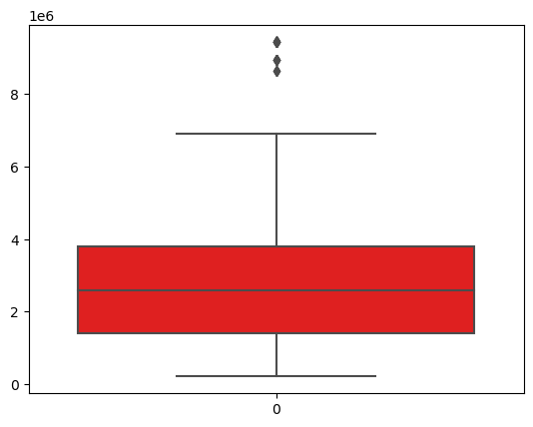
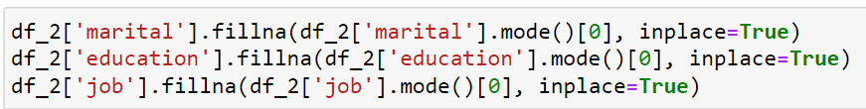
Null imputation based on distribution of Numerical Features(dataset 2):

Slide 8
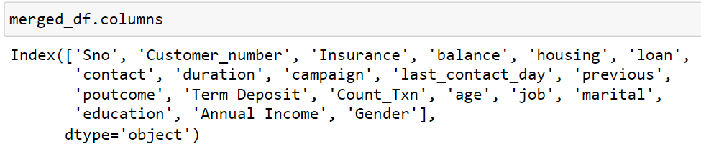
Merge Dataset 1 & 2:
Data preprocessing for both datasets for df_1 and df_2 are done and now we merge them as one dataset and perform analysis
Given that we have a common 'customer_no' column in both datasets, using an inner join would likely be the best choice in most cases and allows us to do analyzing only the data for customers who exist in both datasets, ensuring that you're working with complete information for those customers.

Slide 9
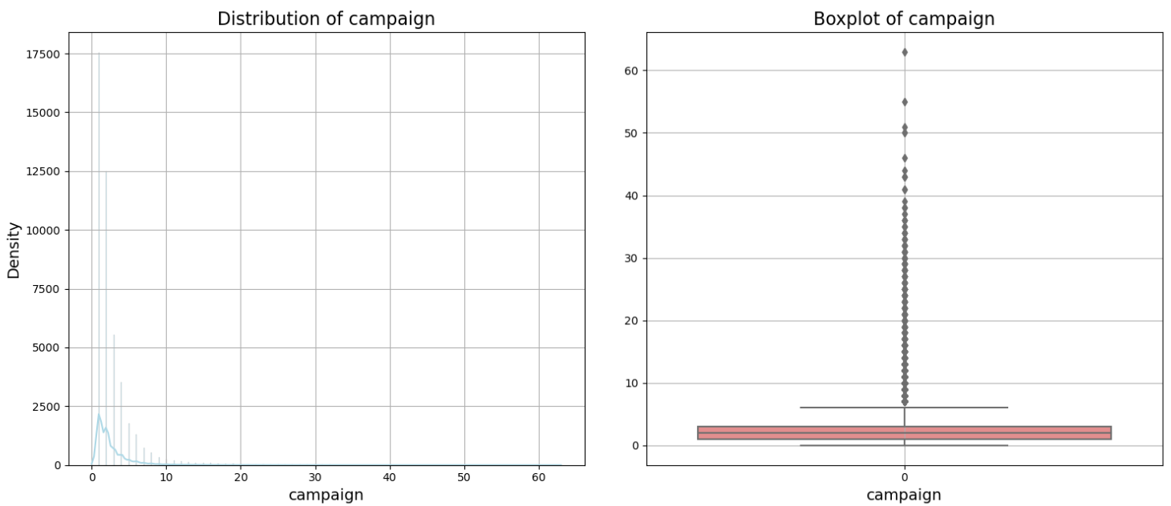
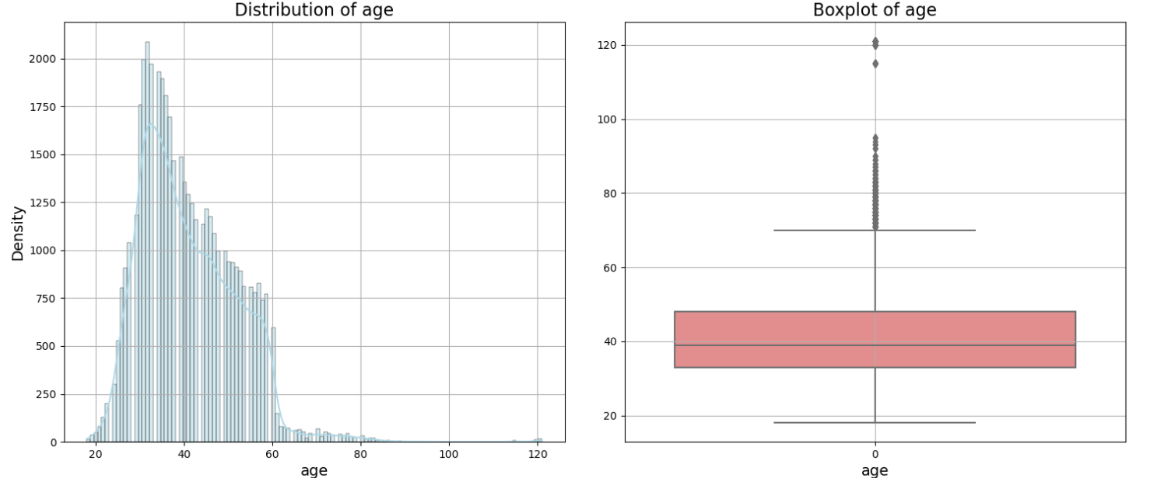
Outlier detection:
Almost all the numerical features contain the outliers and skewed,
So before treating the outliers we have to build base model,so accordingly we treat them if needed to improve the model performance

Slide 10
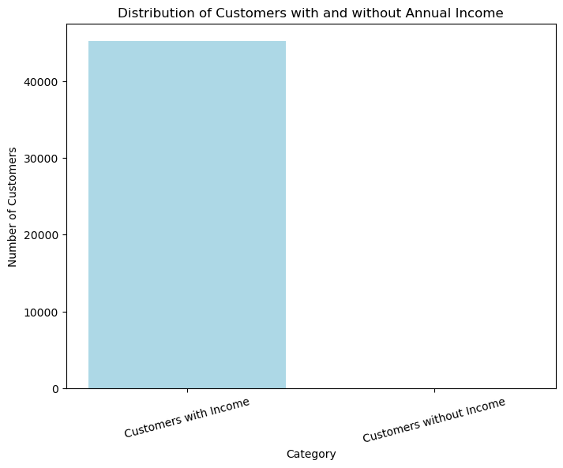
Data Analysis & Visualization: 1. Income Insights: • How many customers have no annual income? Plot and present the data distribution of these customers.
Number of customers with no annual income: 0

Slide 11
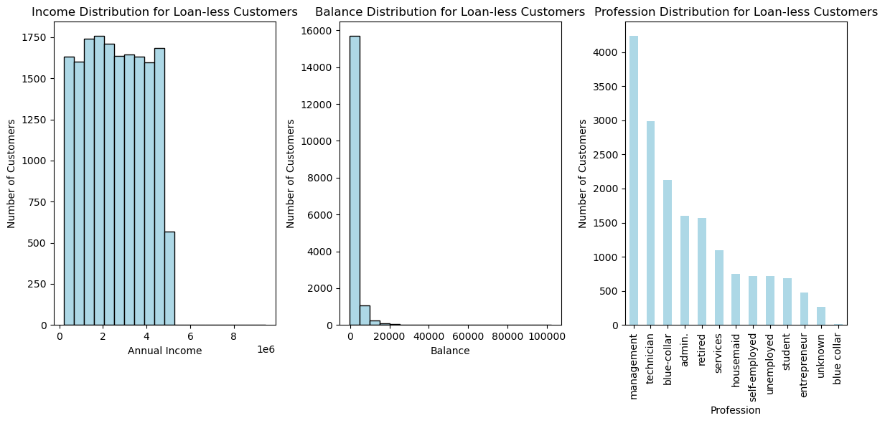
2) Loan-less Customers Profile: • Filter out customers who don’t have any type of loan. Plot the distribution of their Income, balance, and profession. How do these metrics differ from those with loans?
Annual Income: The mean annual income is slightly higher for loaned customers (2,602,288) compared to loan-less customers (2,587,248). However, the difference in means is relatively small.
Balance: Loaned customers have a lower mean balance (1,208.27) compared to loan-less customers (1,752.97). Loan-less customers also have a wider range of balance values, with both negative and high balances.
job:also People dont take loans are from management,technicians etc and customers who take loans are having blue collar jobs

Slide 12
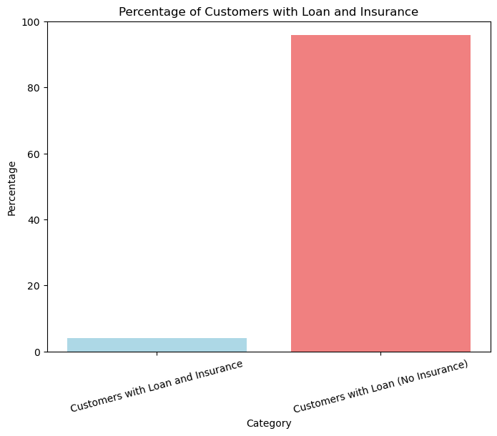
3. Loan and Insurance Analysis: • Calculate the percentage of customers with a loan who have taken out insurance. Visualize this data and discuss potential implications.
Percentage of customers with a loan who have insurance: 4.16%

Slide 13
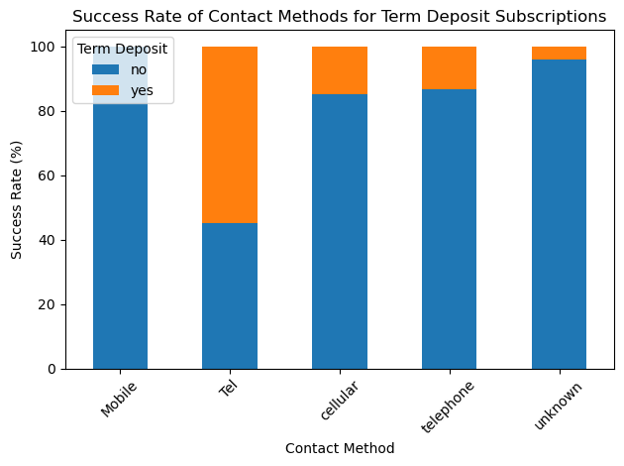
4)Communication Strategy Insights: Analyse and summarize the best Contact method (with the highest success percentage) to contact people to ascertain the status of term deposit subscriptions.
It seems that "telephone" and "Tel" are likely two variations of the same contact method, but with slightly different labels might be due to data inconsistency .
We can assume that these both are same contact method,when the customers are contacted through Telephone there are more chances that they would subscribe to Fixed deposit

Slide 14
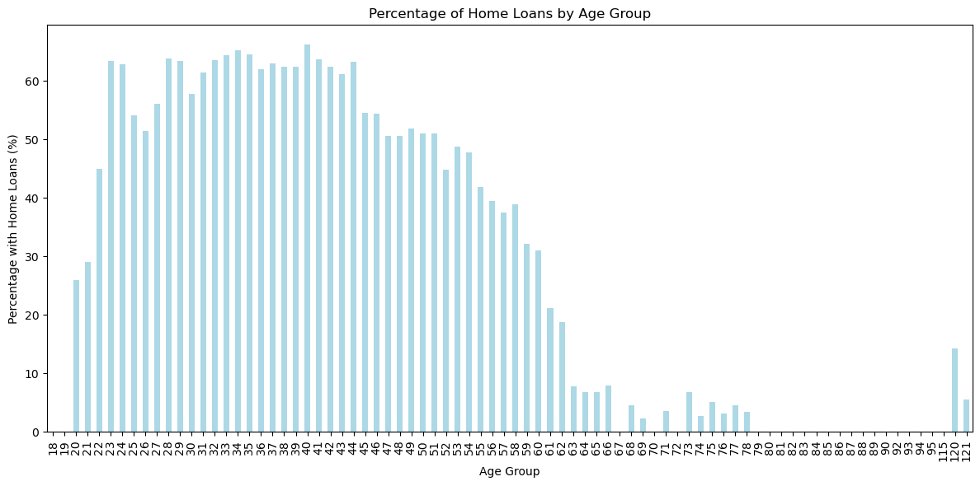
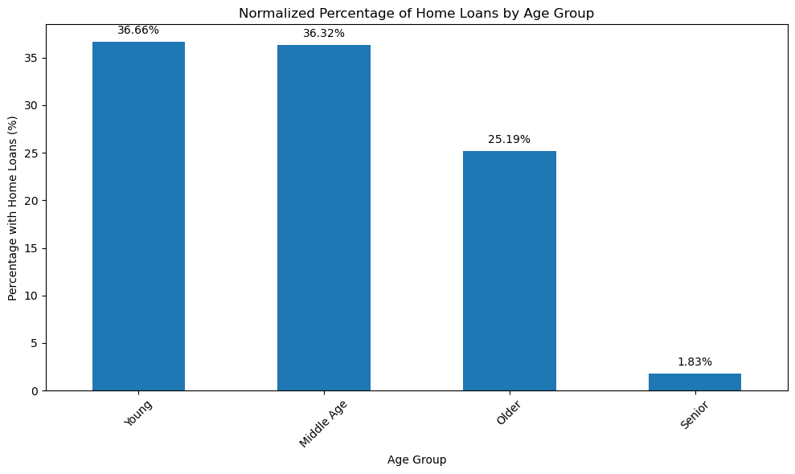
5)Age and Home Loans: Determine which age group has the highest percentage of home loans. Present this data visually and discuss possible reasons.
The age group with the highest percentage of home loans is 40 with a percentage of 66.27%.
Customers aging between 18 to 35 has taken most home loans with 36.66% which is approximately equal to customers who have taken loan aging 35-50

Slide 15
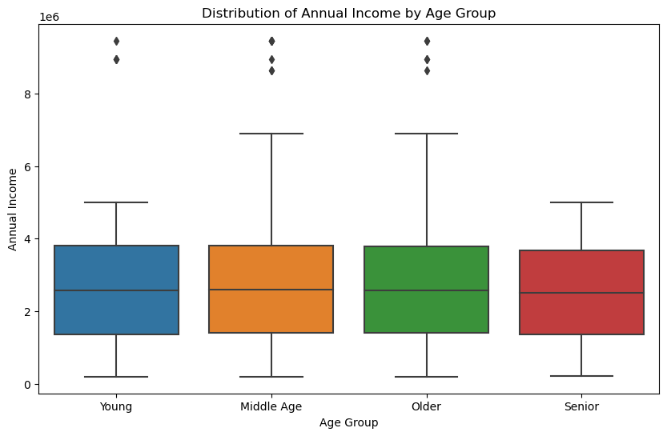
6) Income and Age Relationship: Investigate any relationships between annual income and age group. Use appropriate plots and statistics to present the findings.
Middle aged and older aged customers have approximately same annual income
But across the age groups, we found that the average annual income values were relatively similar. There is not a substantial variation in average income among these groups.
While we observed similar average income values across age groups, this does not shows relationship between the variables.

Slide 16
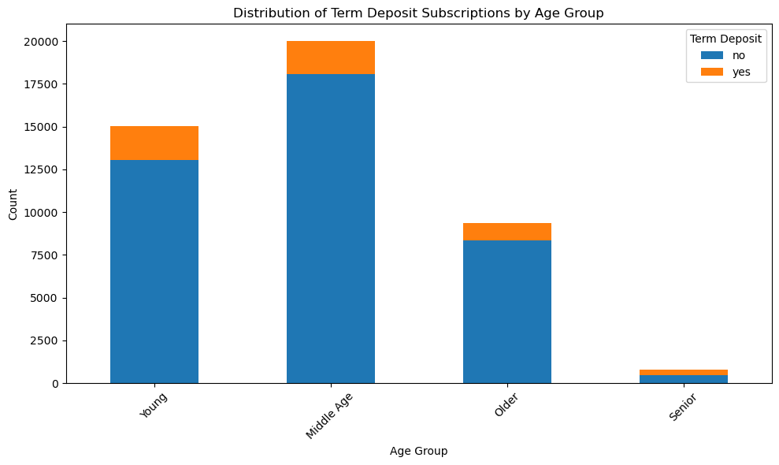
Other Analysis:
Customers aging between 18 to 50 has subscribed to Term deposit compare to customers aged above the 50

Slide 17
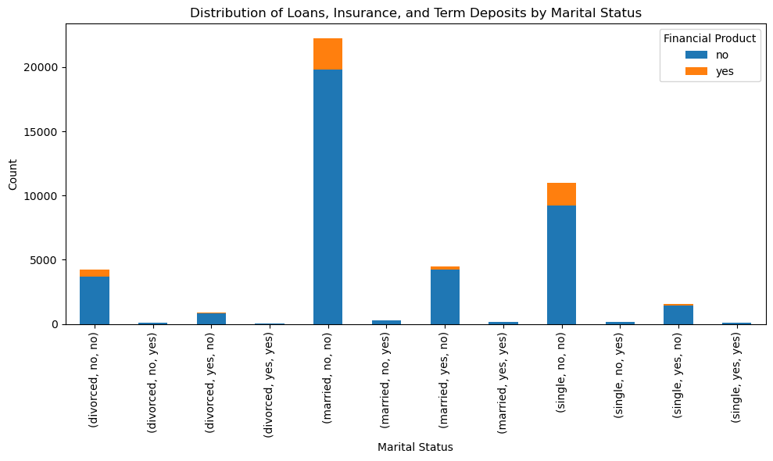
Other Analysis:
Divorced Individuals: Divorced individuals who do not have a loan show a relatively higher chances of subscribing term deposit compared to those with a loan.
Single Individuals: The success rates among single individuals are relatively consistent, regardless of loan status. This indicates that for single individuals, the presence of a loan may not significantly impact their likelihood of subscribing to a term deposit.
Married Individuals: Those without a loan have a higher success rate compared to those with a loan.

Slide 18
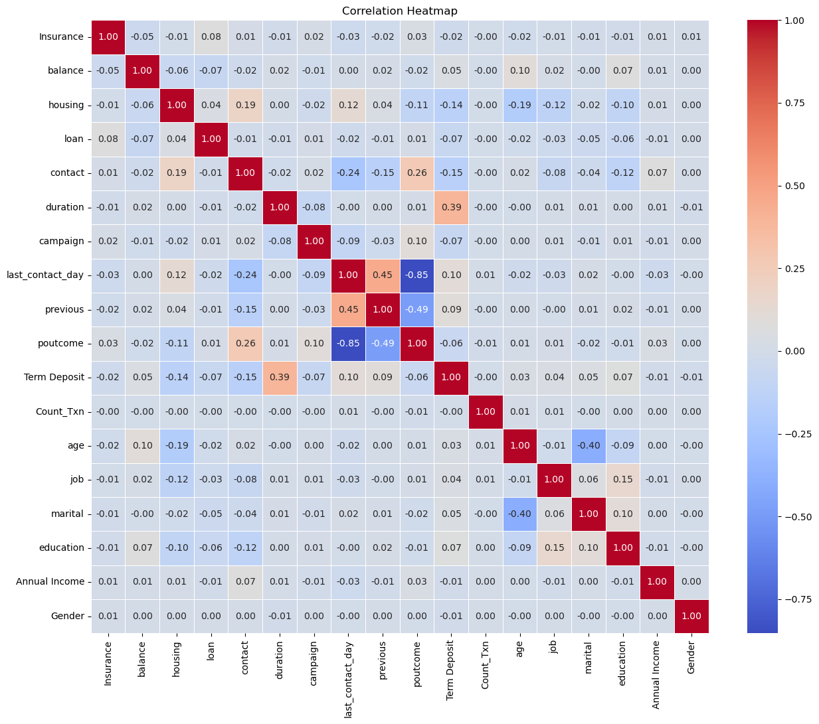
Correlation Analysis:
Out of all features Insurance, Balance, Housing, Loan, Contact, Duration, Campaign, Last Contact Day, Previous, Poutcome,the highest correlation appears to be with the "Duration" column, suggesting that the duration of the contact has a relatively strong positive correlation with the success of the term deposit subscription. This is intuitive, as longer conversations might indicate more interest and engagement.
This column appears to represent the count of transactions and its correlation with the "Term Deposit" column is close to zero, indicating that it has little influence on term deposit subscription.

Slide 19
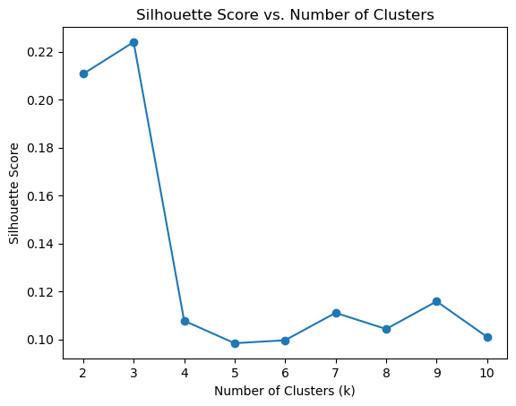
Clustering Analysis:
A silhouette score of 0.1 to 0.22 suggests that the clusters are overlapping and not well-separated so clusters are overlapping
Since earlier we had performed the correlation analysis, in that we have seen that there was no relationship among the variables so these might be the reason for overlapping of clusters,since Clustering algorithms attempt to group similar data points together based on certain features

Slide 20
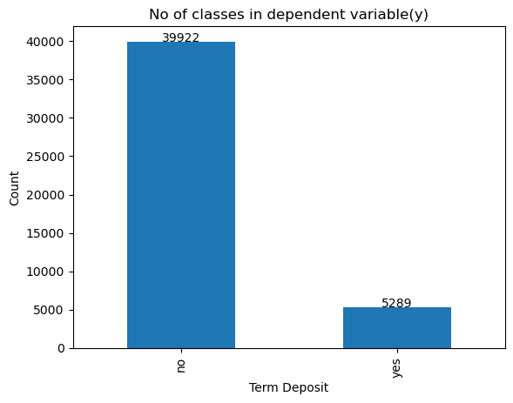
Check for imbalanced dataset:
The output class is imbalanced in our dataset. The output class has two categories: "Yes" and "No" The count of samples in each category is as follows:
"no": 39922 samples
"yes": 5289 samples
Since our dataset is imbalanced so lets create the base model ans check for model accuracy further we carry out feature selection,upsampling the data

Slide 21
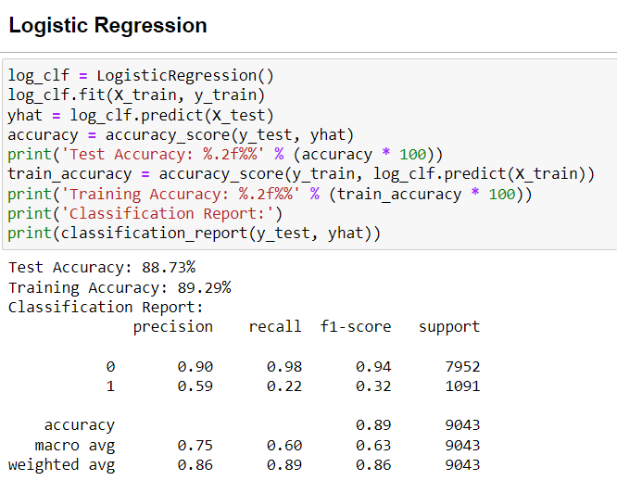
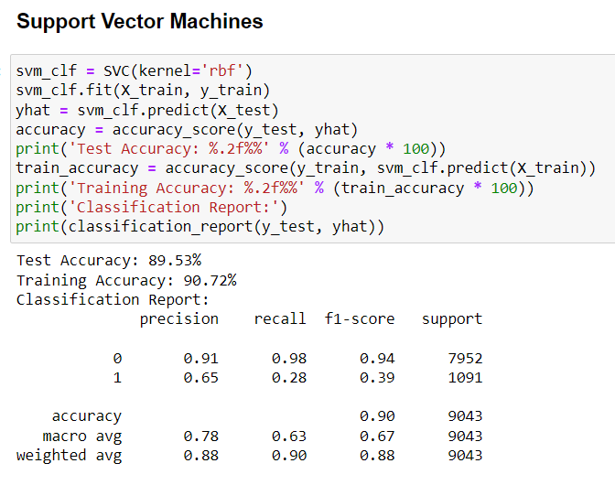
Model Building:
Results:
As we can see that for each model built we can observe that
Precision:class 0(no)(negative class) has a precision higher, and class 1 (positive class) has a precision is low . This suggests that the model is better at correctly predicting class 0.
Recall: Class 0 has a recall high, indicating that the model is good at identifying true negatives. Class 1 has a recall is low comparitively, suggesting that the model struggles with correctly identifying true positives for class 1.
Since the data is imbalanced we could upsample the data

Slide 22
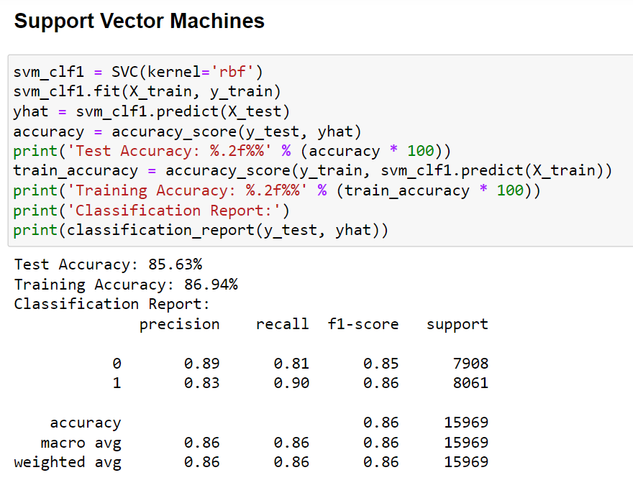
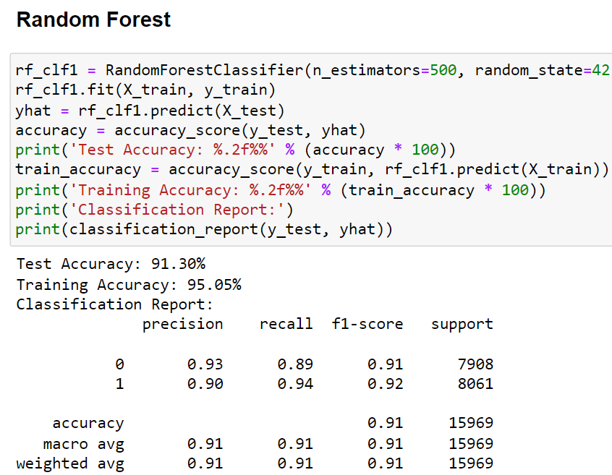
Model Building after upsampling using smote method:
Results:
The model accuracy has been improved where precision and recall for class 1(yes) are well improved
We got good result by using algorithm such as xgboost,knn,random forest after upsampling

Slide 23
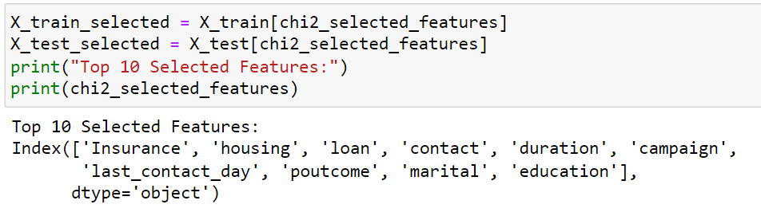
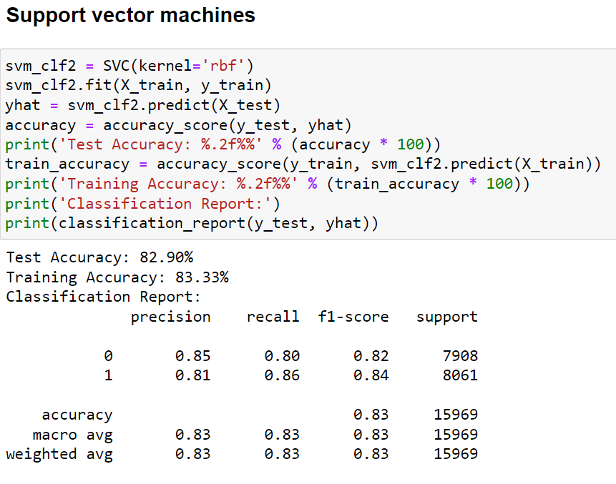
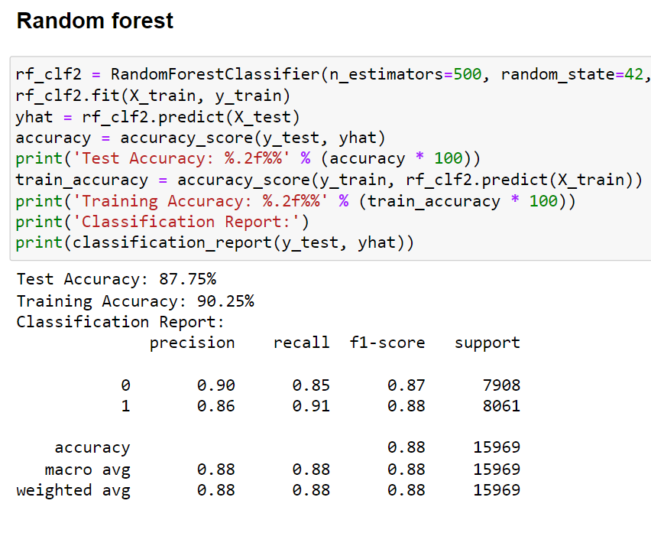
Feature selection using chi2:

Slide 24
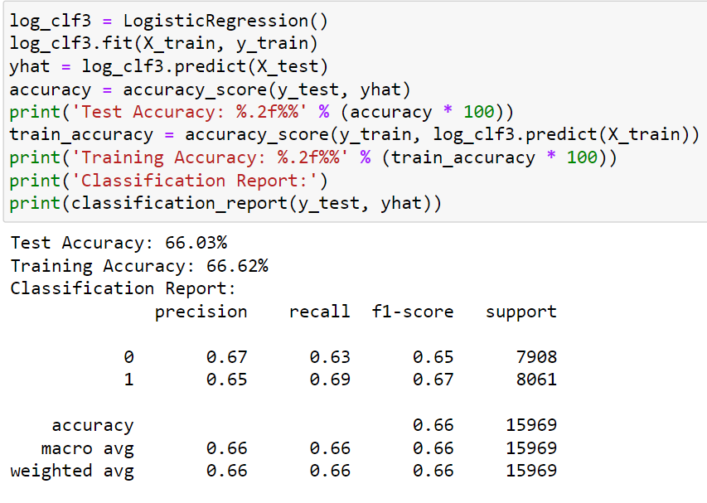
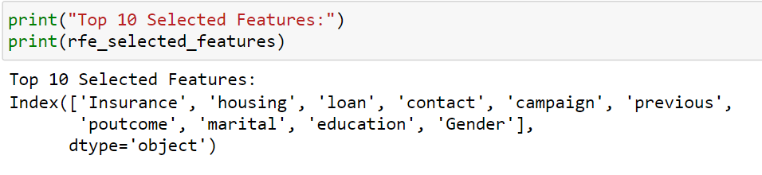
Feature selection using RFE:
Analysis before and after feature selection:
Test and Training Accuracy(Random Forest):
Before Feature Selection: The initial test accuracy was 91.30%, and the training accuracy was 95.05%.
After Feature Selection: The test accuracy dropped to 87.75%, and the training accuracy dropped to 90.25%.
The initial model had a higher test accuracy compared to the model after feature selection, suggesting that the original model was performing better on unseen data.
The drop in training accuracy after feature selection indicates that the model is now less overfit to the training data, which can be a positive outcome.
feature selection seems to have had a mixed impact on the model's performance.

Slide 25
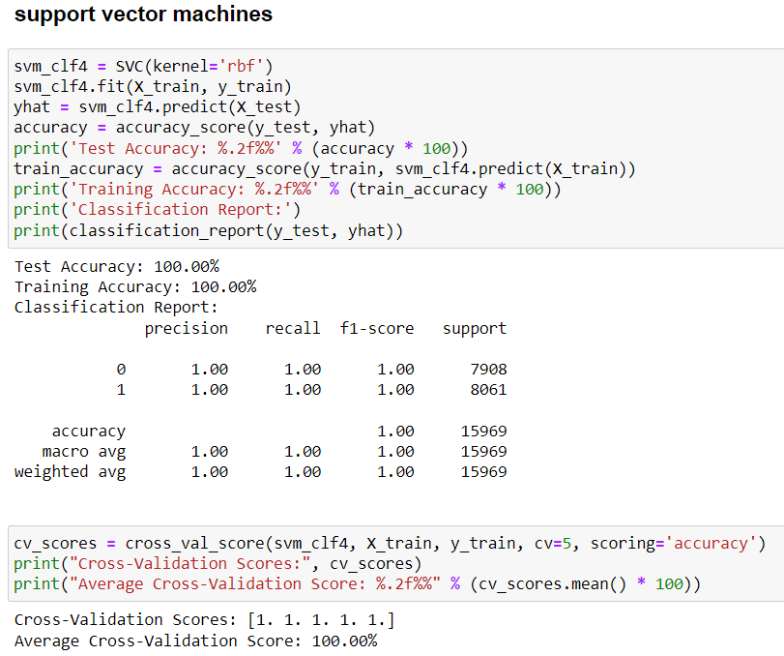
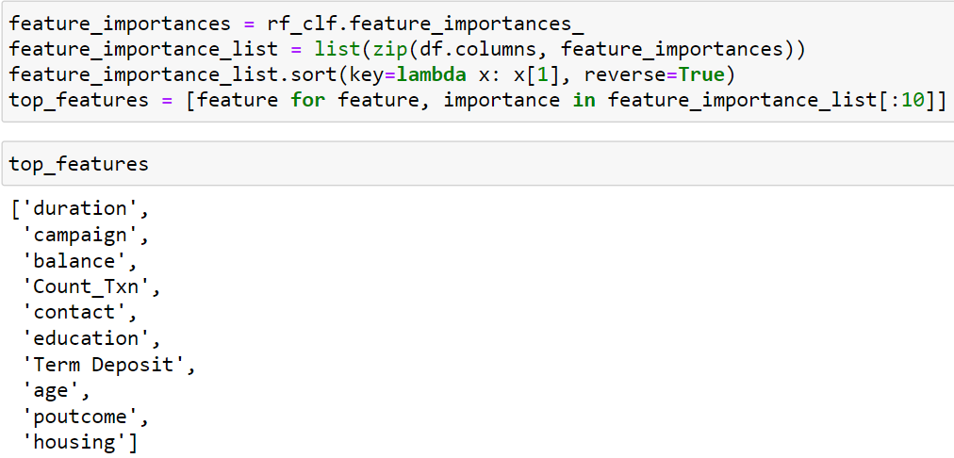
UsingTree based for feature selection:
Both feature selection methods such as chi2 and tree based methods gave good accuracy on both Train and test data with well balanced precision and recall for class 1(Yes) and drop in overfitting.

Slide 26
Conclusion:
The common features in both the Random Forest Feature Selection and the Chi-Squared Test results are:
Out of all features in data only these features tends to be more significant to Term Deposit:
'contact'
'duration'
'campaign'
'poutcome'
'housing'
Contact: This feature could be crucial as it indicates the communication method used to reach out to customers. A more effective and personalized contact method could positively influence a customer's decision to subscribe.
Duration: The duration of the previous contact with the customer is likely to be significant. Longer interactions might imply more engagement and interest, increasing the chance of a term deposit subscription.
Campaign: The number of contacts made during the campaign could play a role. Too many contacts might lead to annoyance, while an optimal number could improve subscription rates.
Poutcome: The outcome of the previous marketing campaign (poutcome) suggests that if a customer has shown interest or subscribed before, they might be more likely to subscribe again in the current campaign.
Housing: This feature relates to whether a customer has a housing loan. Customers with more stable financial situations (without housing loans) might be more inclined to invest in a term deposit.

Slide 27
Best model after Upsampling:
K-Nearest Neighbors (KNN):
Test Accuracy: 91%
Training Accuracy: 93%
KNN performed on par with Random Forest,xgboost achieving 91% accuracy on the test set. It also showed consistent performance between training and test data
Best model after Feature Selection using chi2:
Xgboost:
Test Accuracy: 90%
Training Accuracy: 88%
Xgboost performed on par with Random Forest,svm,knn,xgboost achieving 88% accuracy on the test set. It also showed consistent performance between training and test data

Slide 28
Thank You Contact details: Ph.no:+91 8660419121 email:madan.maddy890@gmail.com

